Slide 1
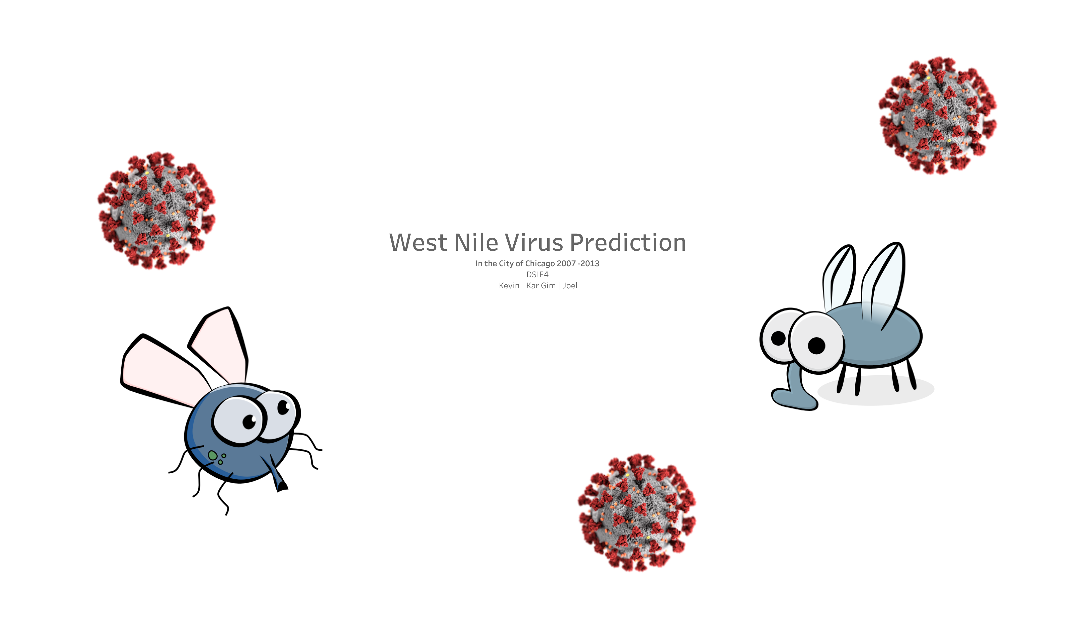
West Nile Virus Prediction
City of Chicago 2007 -2013
DSIF4
Kevin | Kar Gim | Joel

Slide 2
Background
History of the West Nile virus:
The West Nile virus was first identified 85 years ago in eastern Africa, Uganda. It was then discovered to have been transmitted to the United States in the summer of 1999. Researchers believe the West Nile virus is transmitted to a person by mosquitos that has bitten an infected bird before.¹
Its presence has been confirmed in the city of Chicago in September 2001, via laboratory tests on 2 dead crows found in the area.²
Problem Statement
We have just graduated from General Assembly Data Science Immersive program and managed to secure an interview with the Disease And Treatment Agency, division of Societal Cures In Epidemiology and New Creative Engineering (DATA-SCIENCE). We have been assigned into a group with other interviewees and was given a take home BI test. We will be required to work together and present as a group during the interview.
The Test: "Due to the recent epidemic of West Nile Virus in the Windy City, we've had the Department of Public Health set up a surveillance and control system. We're hoping it will let us learn something from the mosquito population as we collect data over time. Pesticides are a necessary evil in the fight for public health and safety, not to mention expensive! We need to derive an effective plan to deploy pesticides throughout the city..."
Stakeholders
We are presenting to interviewers from the data science department. Some members of the audience will be data scientists, biostatisticians and epidemiologists who will understand our models and metrics and will want more information. Others will be decision-makers, focusing almost exclusively on our cost-benefit analysis.
Source:
1. https://medlineplus.gov/ency/article/007186.htm#:~:text=West%20Nile%20virus%20was%20first,and%20then%20bites%20a%20person.
2. https://dph.illinois.gov/topics-services/diseases-and-conditions/west-nile-virus.html#:~:text=In%20Illinois%2C%20West%20Nile%20virus,found%20in%20the%20Chicago%20area.

Slide 3
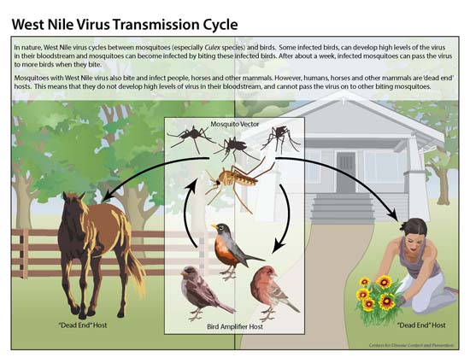
Table of Contents
- Data Cleaning
- Exploratory Data Analysis
- Pre-processing
- Model training and selection
- Cost Benefit Analysis
- Conclusion and Recommendation
Source: From the CDC: http://www.cdc.gov/westnile/transmission/index.html

Slide 4
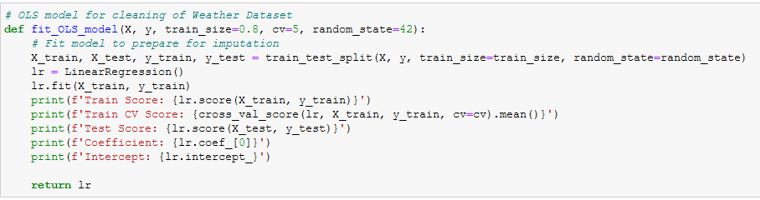
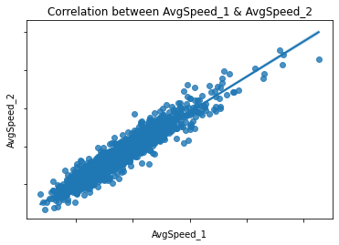
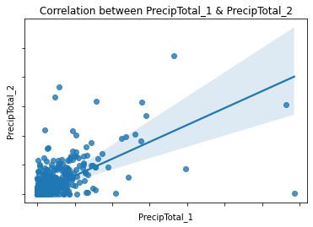
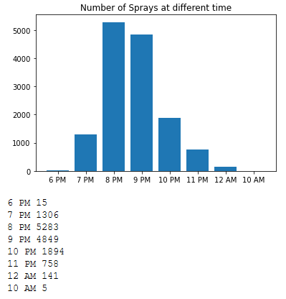
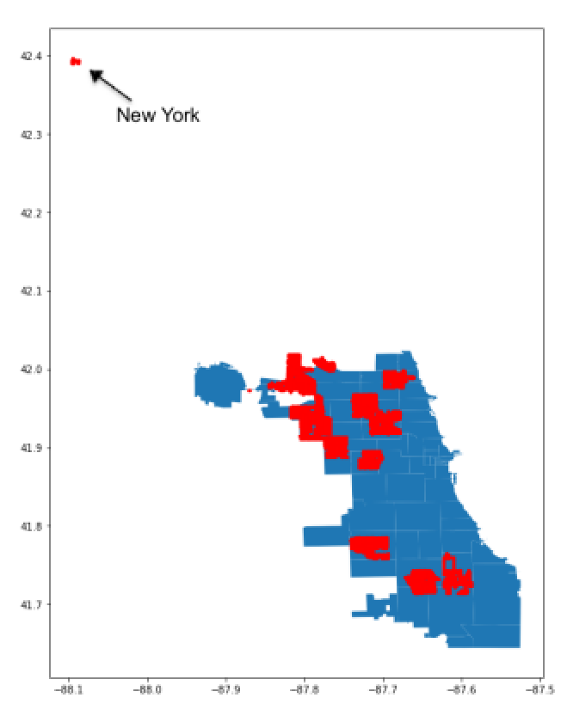
Data Cleaning
Weather Dataset
There were a total 7,552 missing values in the weather dataset which made up 12.83% of the total dataset
As such we split the station 1 and 2 data and drop the columns that has very high percentage of missing data
For remaining missing data, correlation between features were checked and plugged into a Linear regression model to fill in the missing data.
Spray Dataset
There was missing data in only the Time column, and after doing some simple exploration, we decided to drop it as it help no relevance to the issue at hand
Some data on spray occurring in New York was also captured in the dataset and as such we decided to drop them also
Train Dataset
While there were no null values, it contained extra information that was not needed, like address, block and street which were all captured under the Latitude and Longitude given. As such we decided to drop them too.

Slide 5
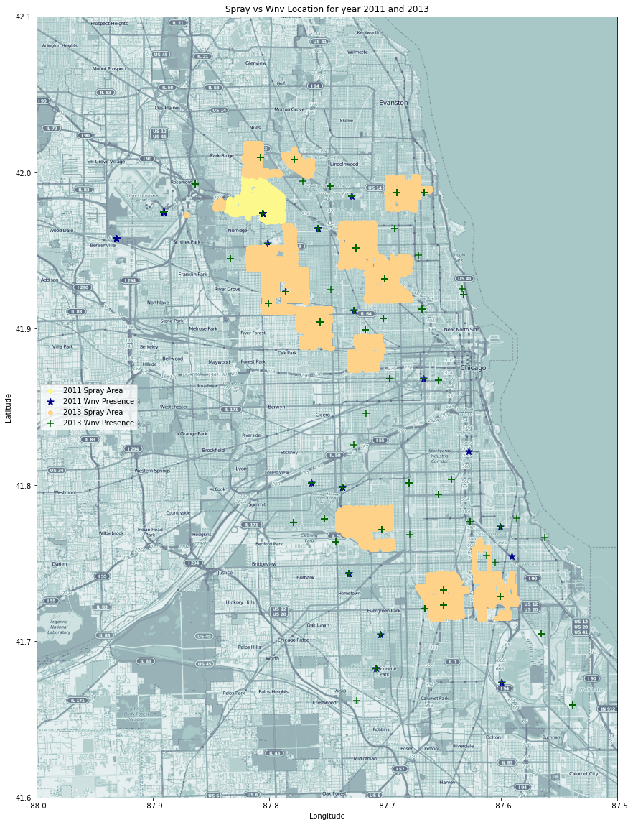
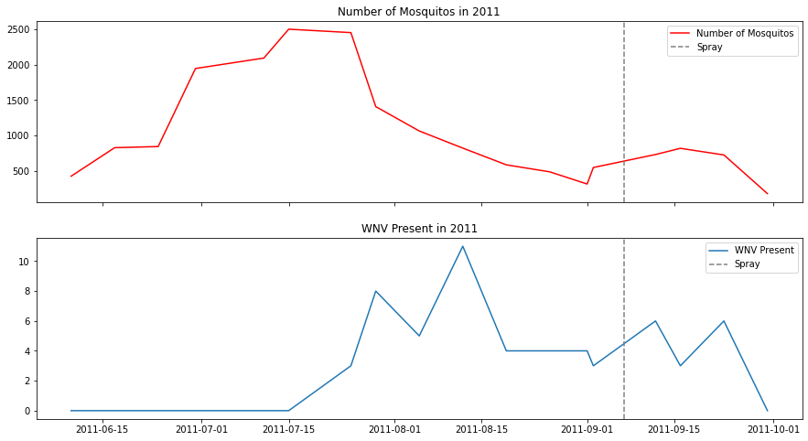
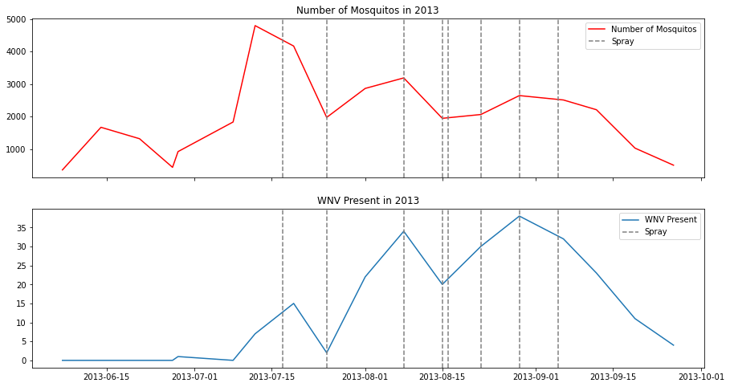
EDA – WNV BROKEN INTO YEARS MONTHS SPECIES
From the map we can see that the spray areas do not cover most places where the trap were placed in both 2011 and 2013. This most likely would give a poor correlation between the spray result and the presence of the West Nile virus.
When we plot the number of mosquitoes and West Nile virus present in both years and marked when the spray occurred, it cemented the fact that the spray data is too little over too small an area for us to use in any significant way.
In fact, for 2011, it shows the virus spiking after the spray occurred, but this is most likely in areas not covered by the spray. With this, we decided not to use the spray data in our analysis and machine learning later on.

Slide 6
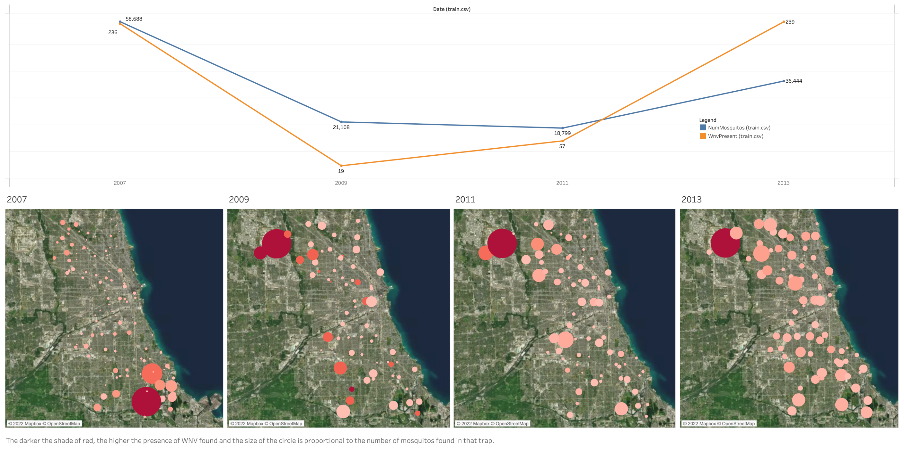
EDA – Broad Comparison of the Number of Mosquitoes vs WNV Throughout the Years

Slide 7
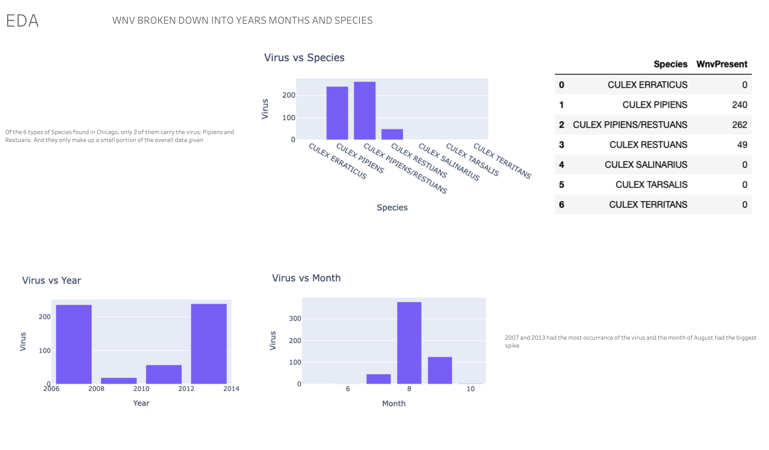
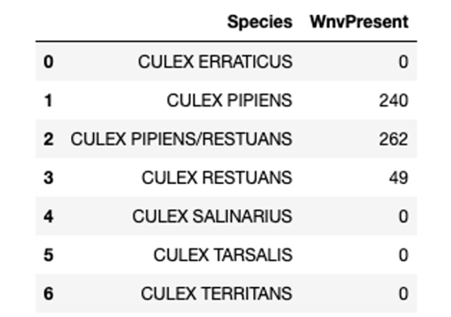
EDA – WNV BROKEN INTO YEARS MONTHS SPECIES
Of the 6 types of Species found in Chicago, only 2 of them carry the virus: Pipiens and Restuans. And they only make up a small portion of the overall data given.
2007 and 2013 had the most occurrence of the virus and the month of August had the biggest spike.

Slide 8
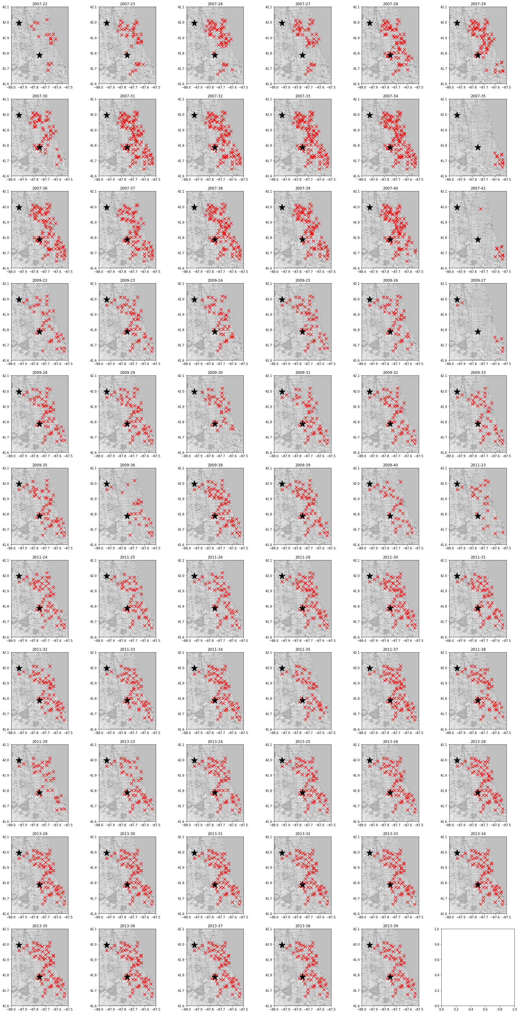
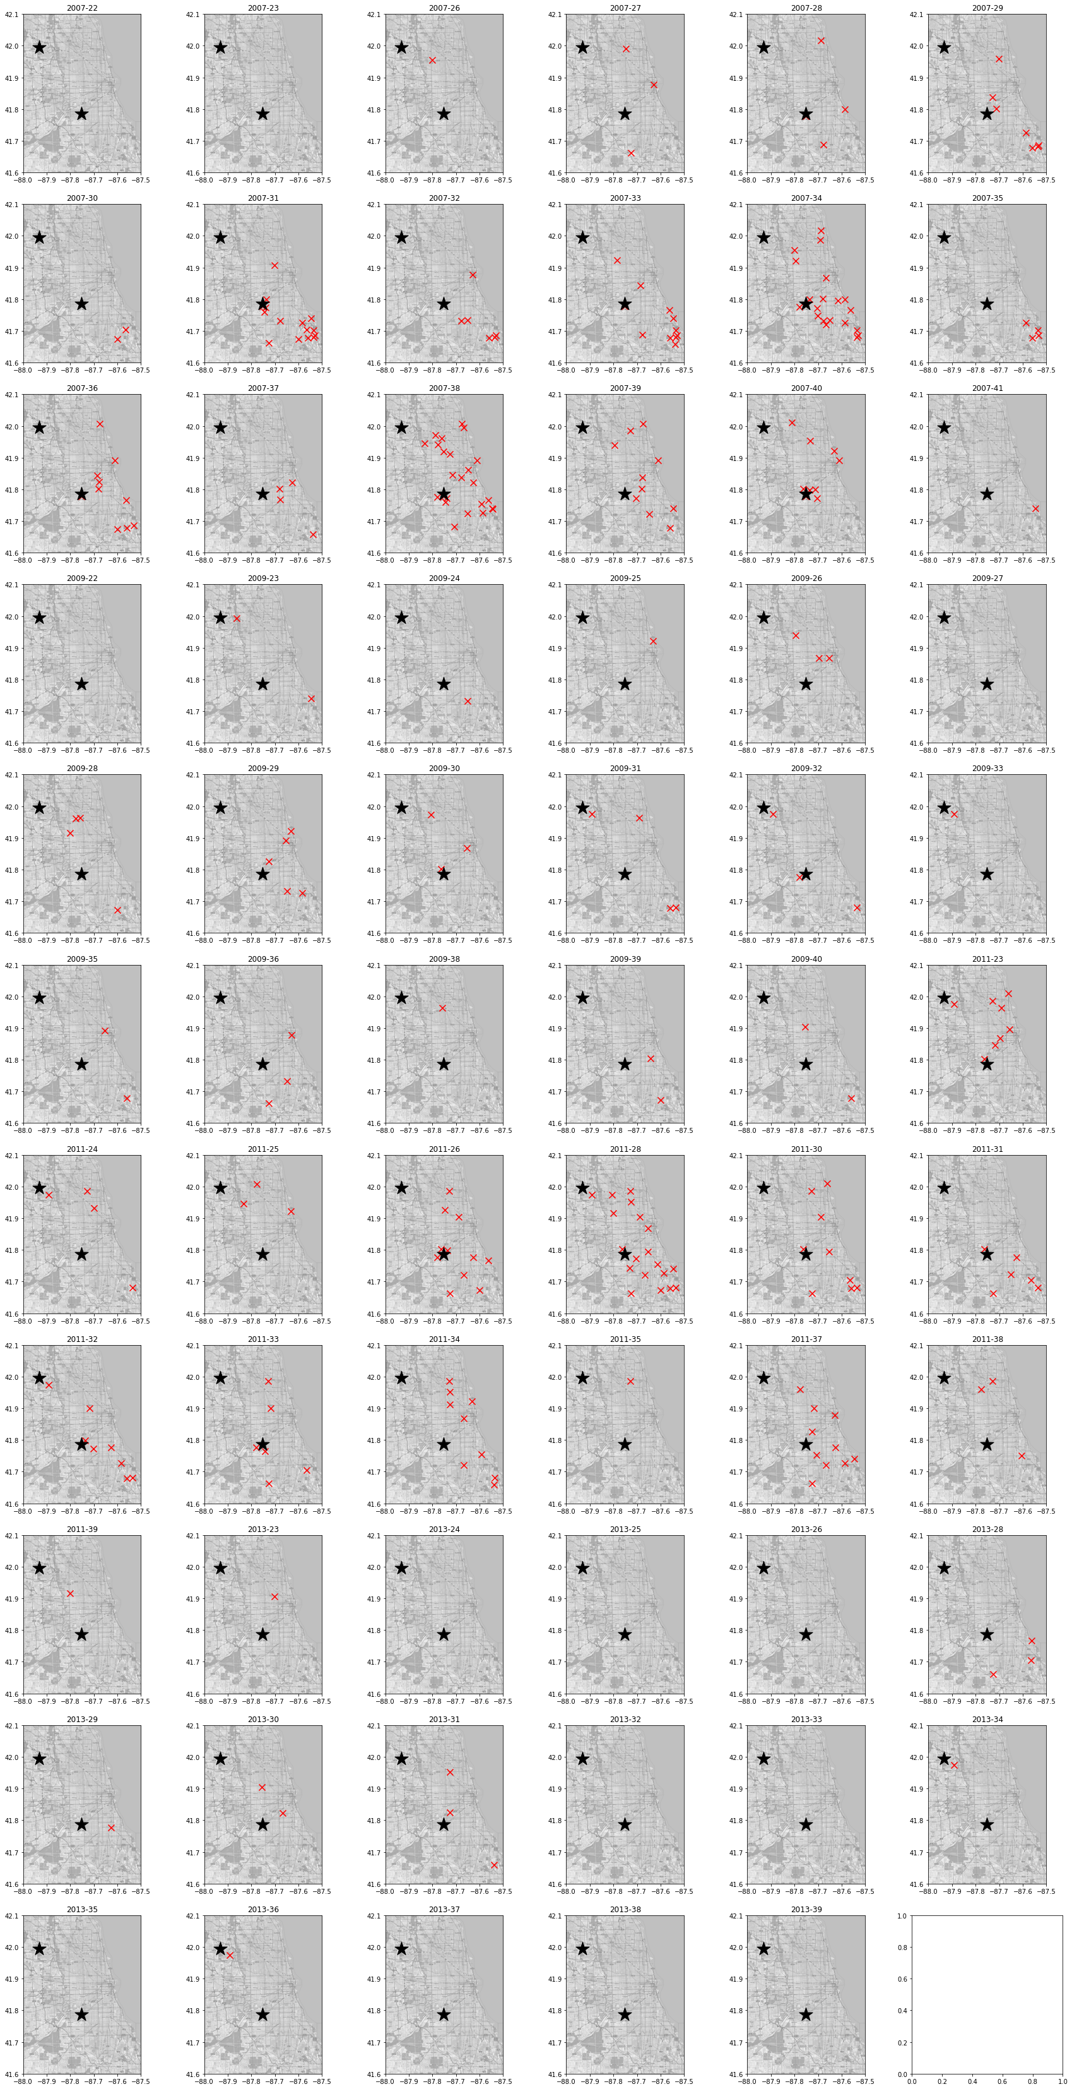
EDA - EXPLORING SPECIES PIPIENS AND RESTUANS BY WEEK
Generating weekly plots of these two species, we uncovered the following findings:
Most traps captured species of interest except for:
2007-22
2007-35
2007-41
2009-27
WNV potential species (CULEX PIPIENS/RESTUANS, CULEX PIPIENS and CULEX RESTUANS) are found in all/most of the traps.
WNV non-potential species (CULEX SALINARIUS, CULEX TERRITANS, CULEX TARSALIS and CULEX ERRATICUS) are only found in small number of traps with 2009 and 2013 being the lowest among of the 4 years of data
WNV Potential Species
Non-WNV Potential Species

Slide 9
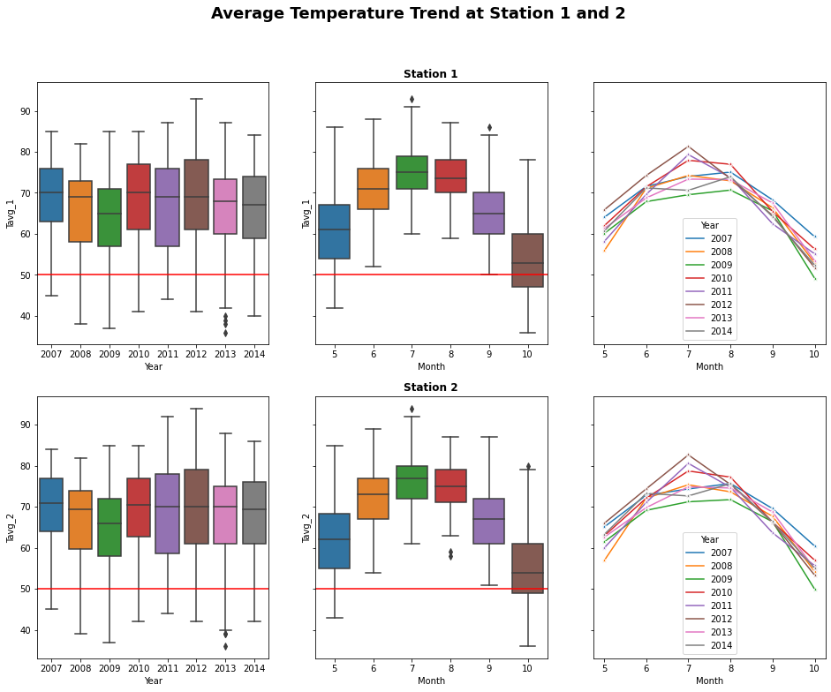
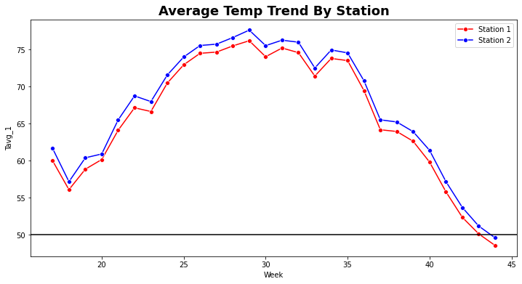
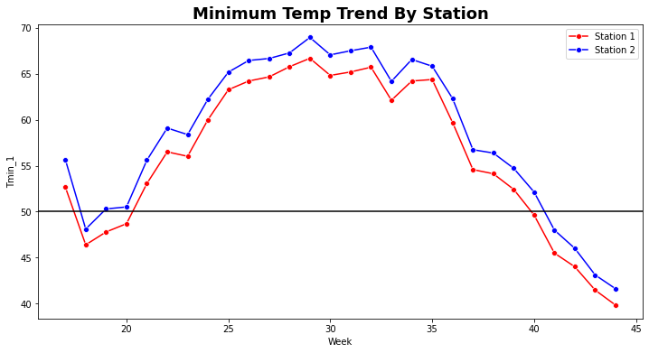
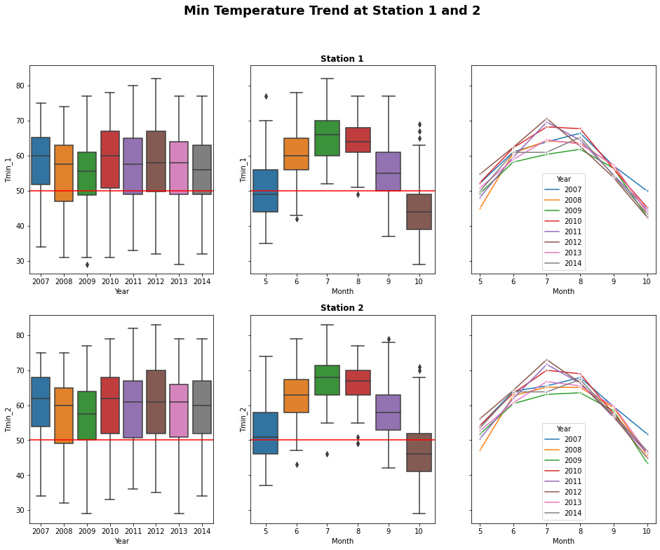
EDA - EXPLORING WEATHER VARIABLES AND FEATURES
Temperature
Station 1 has lower average and minimum temperature (~1 to 2°F) than station 2
Average temperature across the week increases and roughly stabilizes at week 25 to 36 before it starts decreasing
Peak around July to August
Number of mosquitoes should be greatest during July and August as they are inhibited by low temperature (< 50°F)
During year 2008 and 2009, observed slightly medium values for average and minimum temp
Other years have comparable medium values with each other

Slide 10
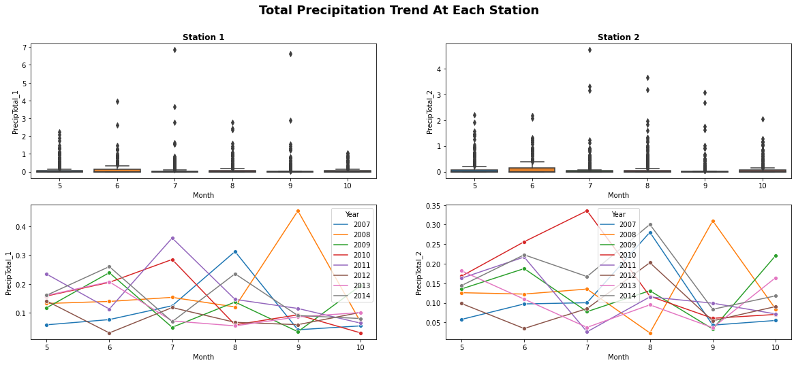
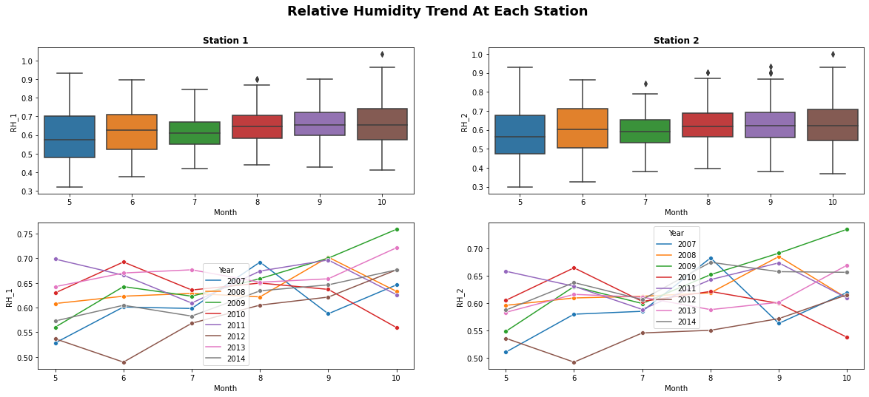
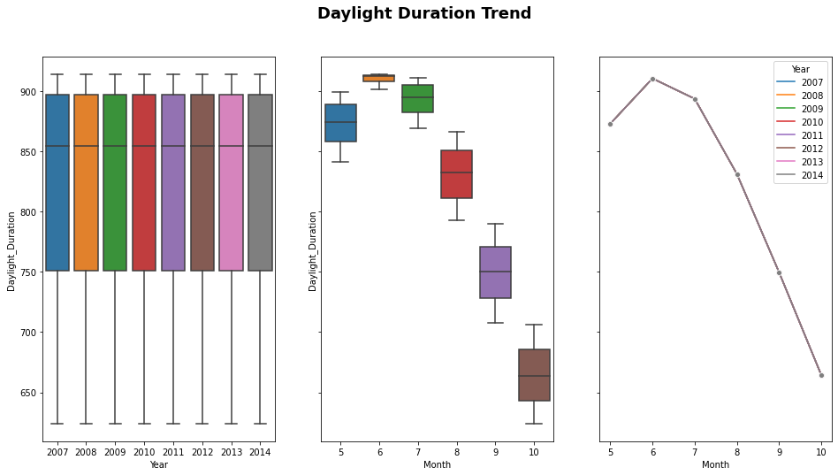
EDA - EXPLORING WEATHER VARIABLES AND FEATURES
Precipitation and Humidity
June has the largest variation in total precipitation
No pattern observed in average precipitation between each month and year
Relative humidity is the highest in October and lowest in May (upward trend)
2012 had the lowest humidity across the months as compared to other years
Daylight Duration
Daylight duration follows an inverted U-shape whereby it peaks in June and is the lowest in Oct
No significant differences between each year
Should observe more mosquitoes and traps with WNV detected during months where the daylight duration are shorter as Culex are more active at night

Slide 11
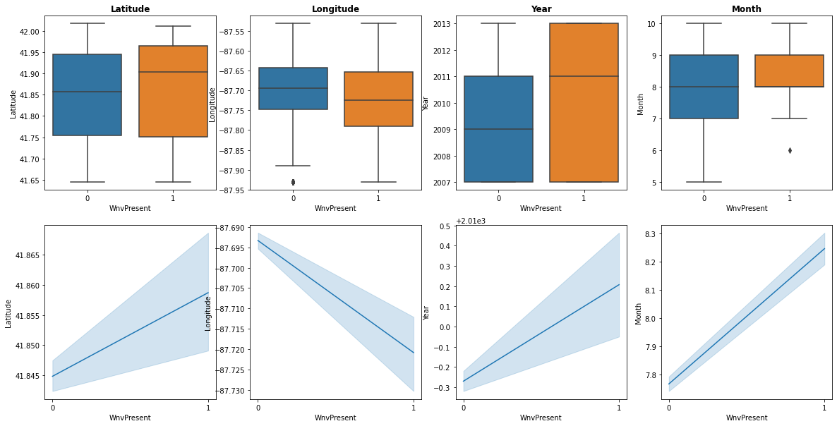
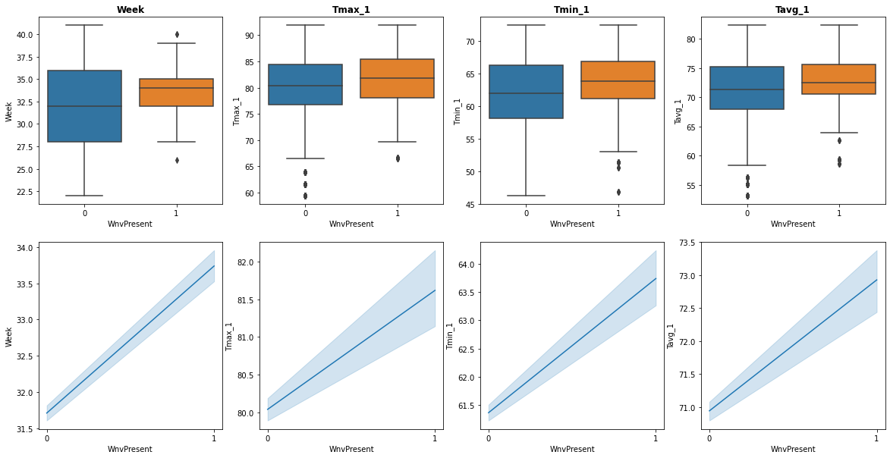
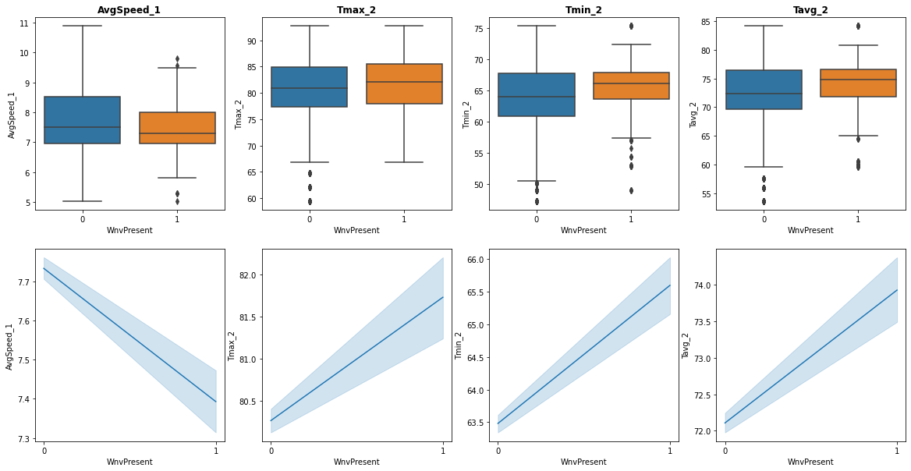
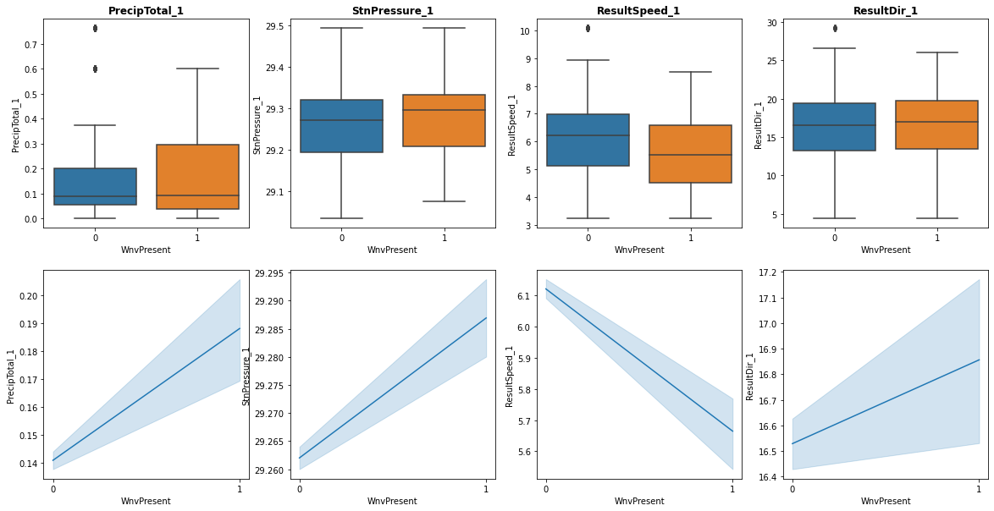
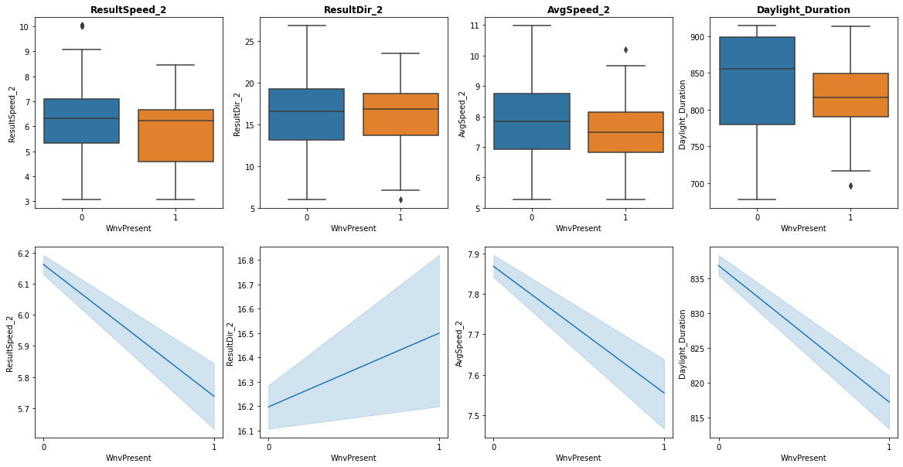
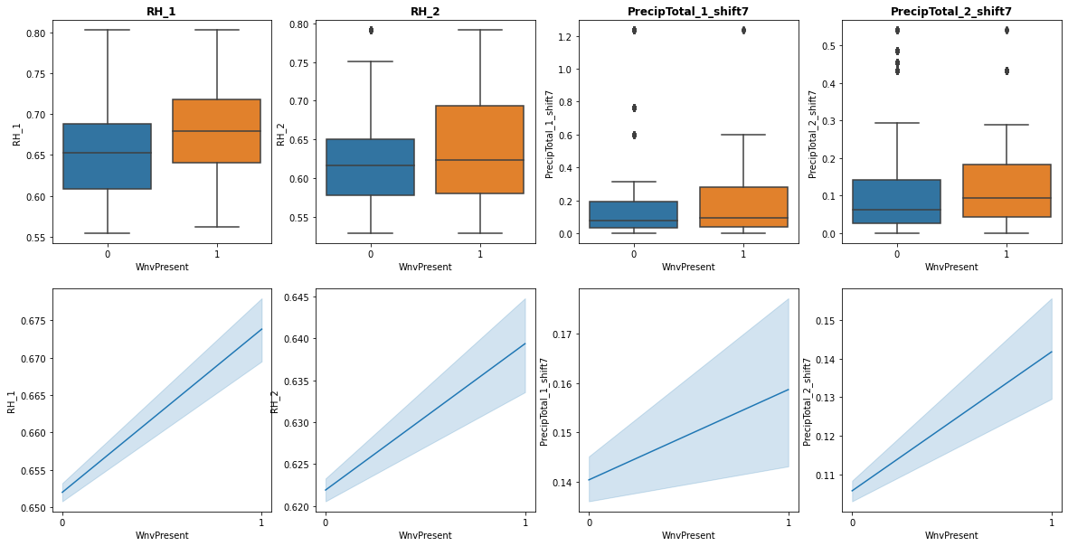
EDA – DISCOVERY AFTER MERGING TRAIN DATA WITH WEATHER DATA
The following factors benefit/affect WNV
Certain months and weeks benefits WNV
Around August to Sept
Higher temperature (Avg, max, min, dewpoint and wet bulb)
Mosquitoes are inhibited by low temperature (< 50°F) and hence reduced the spread of WNV
Lower resultant wind speed
Mosquitoes are not good flyers and lower wind speed would enable them to fly and spread the virus better
Lower daylight duration
Culex are more active at night
Higher relative humidity
Low humidity suppresses mosquitos' activities and could cause their death

Slide 12
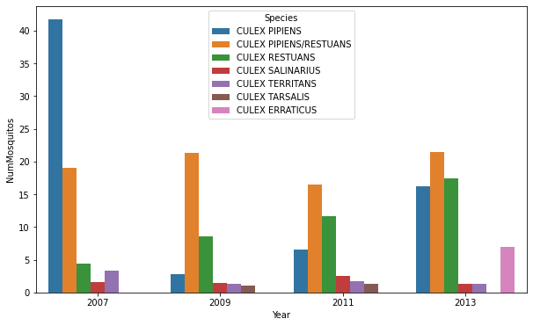
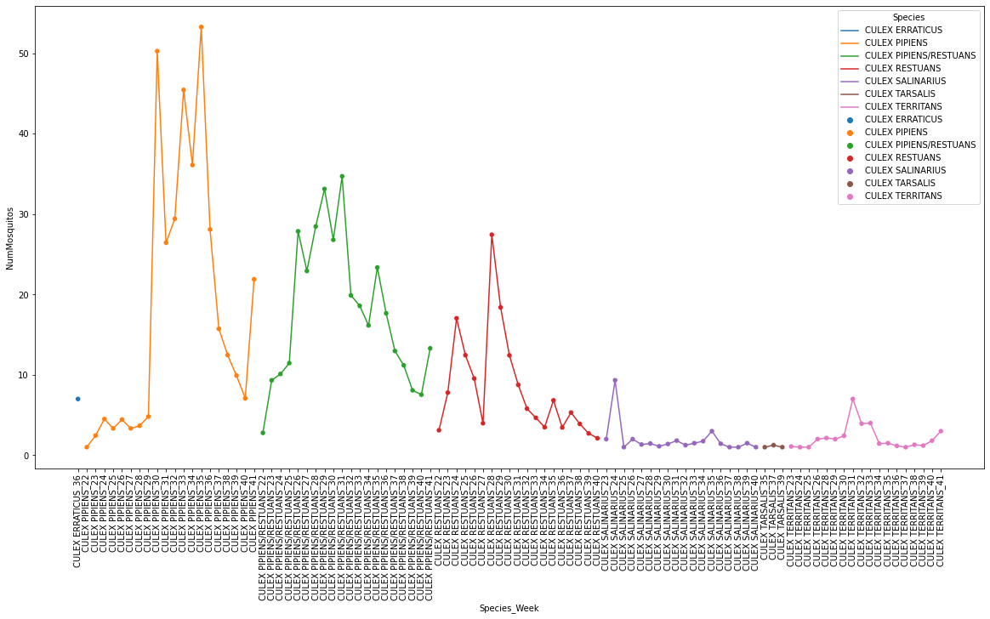
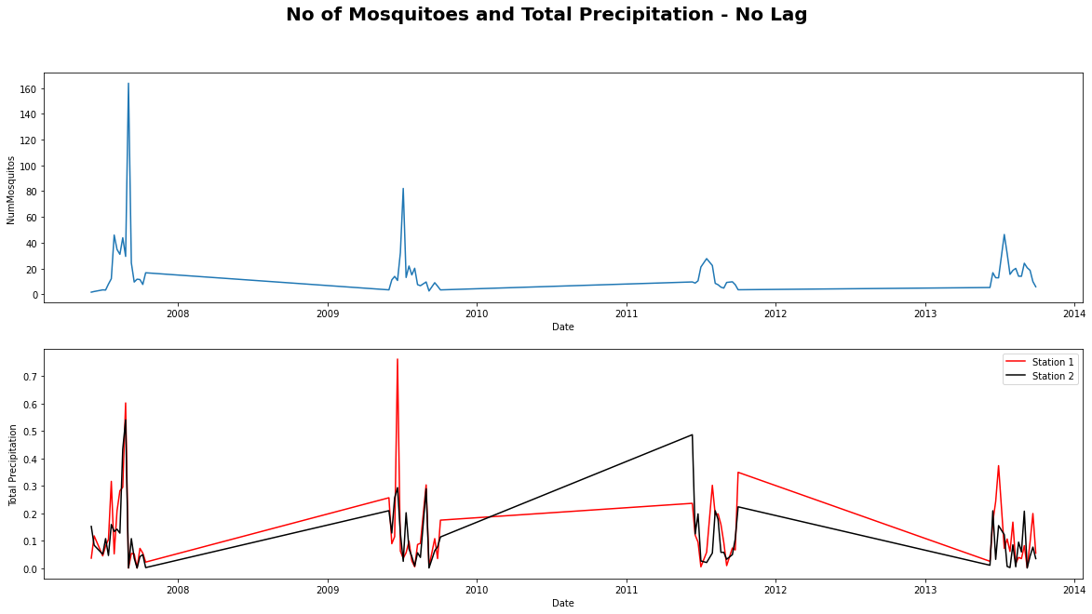
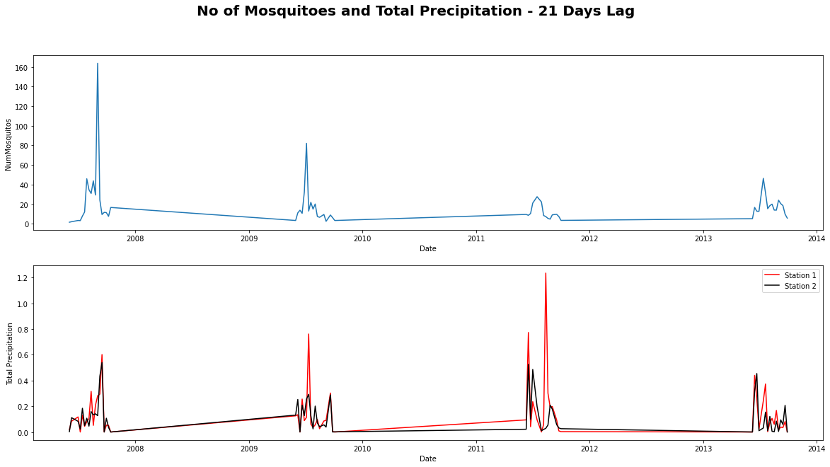
EDA – EXPLORING THE POPULATION OF MOSQUITOES VS TIME AND WEATHER CONDITIONS
How does the average number of mosquitoes vary by the year?
Culex Pipiens had a significantly higher average in 2007. However, by 2009, the average drastically fell before increasing again in 2011 to 2013
Culex Pipiens/Restuans average number of mosquitoes had remained relatively stable across the years
Culex Restuans average number of mosquitoes had been increasing steadily each year
Culex Erraticus only appeared in 2013
Remaining species average had been low and relatively stable
How does average number of mosquitoes varies by the week for each species?
Culex Pipiens has the highest average number and spike of mosquitoes among the 7 species, followed by Culex Pipiens/Restuans and Culex Restuans. The remaining species average number generally remain relatively stable and low during these period
How does the amount of precipitation affect the number of mosquitoes?
Different year seems to require different lag duration. For example, for 2007, 0 lag in total precipitation seems to be match the spike in number of mosquitoes while for 2009, it seems like 21 days lag seems like a better match with the spike for number of mosquitoes

Slide 13
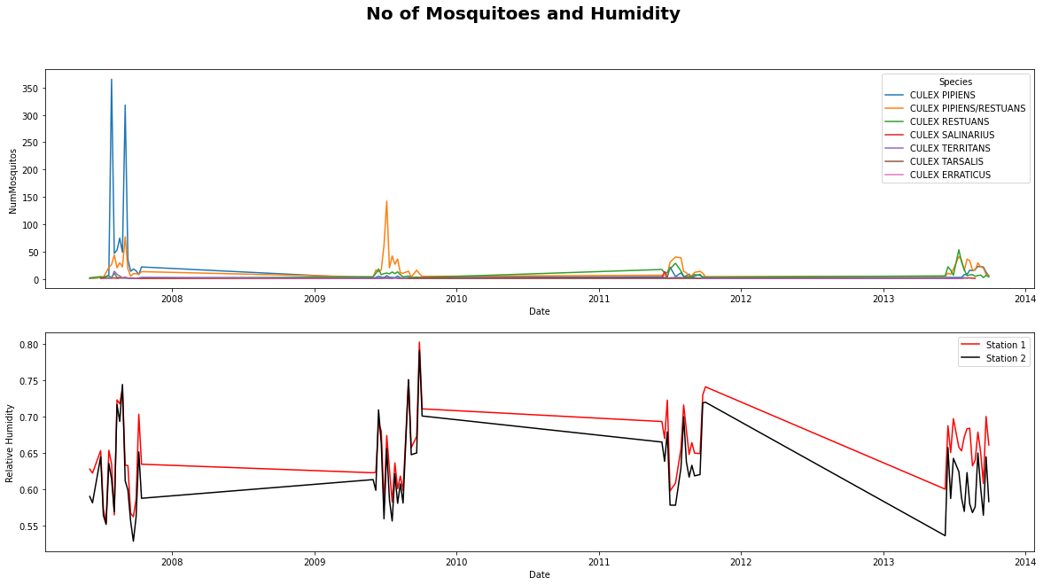
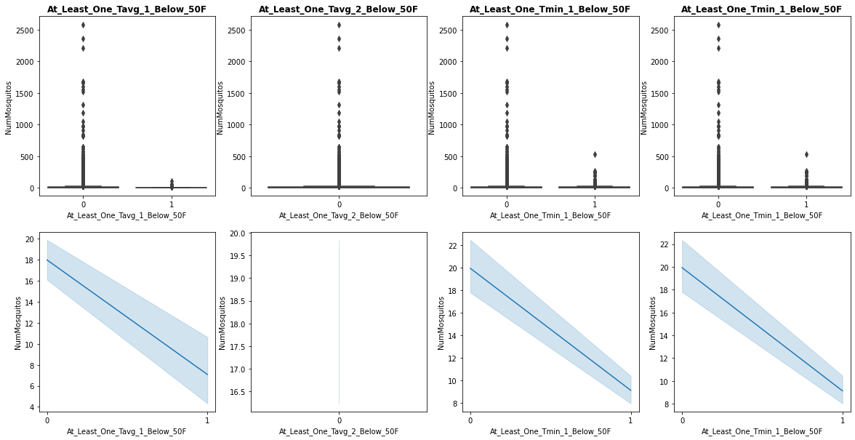
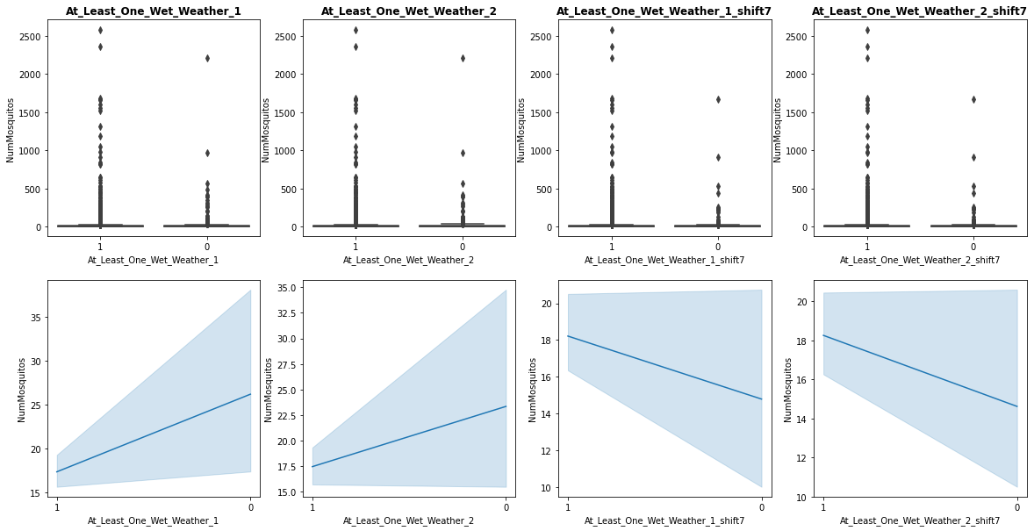
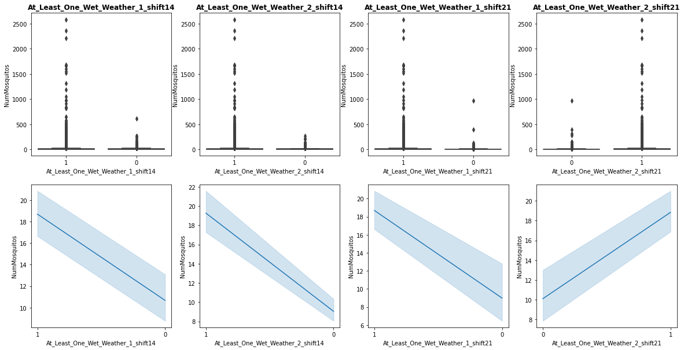
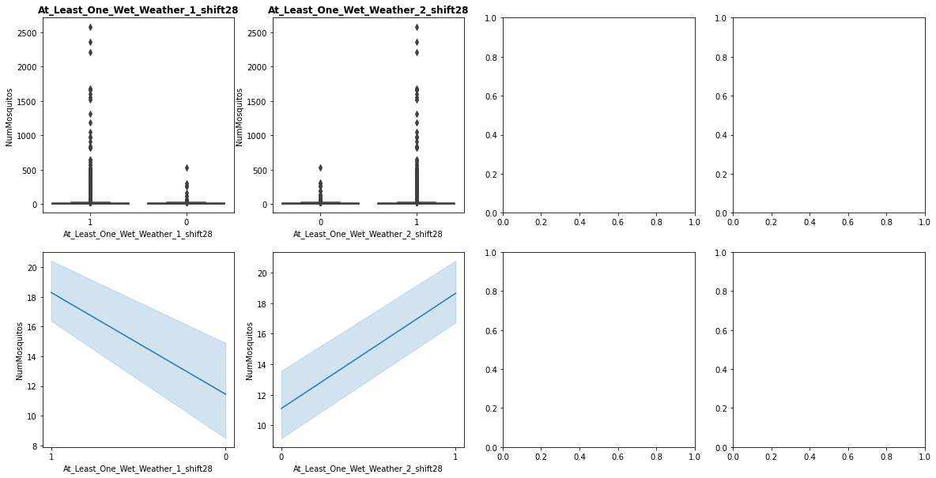
EDA – EXPLORING THE POPULATION OF MOSQUITOES VS TIME AND WEATHER CONDITIONS
How does humidity affect the number of mosquitoes?
While theoretically, higher humidity should encourage more mosquitoes and increase their activities, however, from the trend below, it does not seem to be the case.
Does Average Temp Falling Below 50°F Results in Less Mosquitoes?
When there is at least 1 day in a week that has average temperature falling below 50°F, the number of mosquitoes are lower with less outliers as compared to using minimum temperature.
How having at least 1 wet weather affects the number of mosquitoes?
When data is not offset, having at least 1 wet weather caused the number of mosquitoes to decrease
When data is offset by 1 week to 4 weeks, the trend reversed, and more mosquitoes started appearing especially when it is offset by 2 to 3 weeks

Slide 14
Preprocessing
These features were further dropped from the data after EDA
1. 'NumMosquitos', we will drop this because this feature is not present in the test dataset. We ran a few linear regression models to predict the NumMosquitos in the test dataset. However, we did not get successful enough results to improve our final model in the prediction of the presence of the WNV Virus.
2. 'Species', we will drop this column as the column ‘Is WNV Present' is already indicative of the Species as only certain type of species were found to contain the WNV Virus.
3. 'Year-Week', 'Year', 'Month' and 'Week', we initially thought these to be useful as there are should be more mosquitos and hence a greater probability of the presence of the WNV Virus in certain times of the year. However, these are already covered and touched upon by the other features which describe the weather.

Slide 15
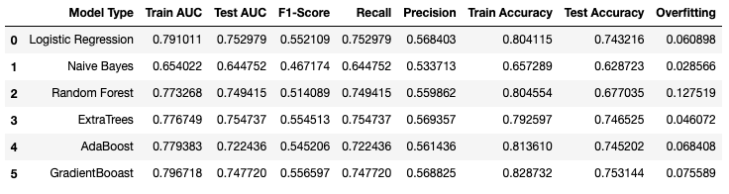
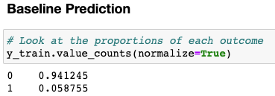
Model Training and Selection
Note:
The data is heavily imbalanced. As such, we optimized our models using AUC score instead of accuracy. We also deployed SMOTE (Synthetic Minority Over-sampling Technique) to help us with over-sampling.
When we apply GridSearchCV to perform hyperparameter tuning, we will need to utilize an imblearn.Pipeline object to handle the imbalanced dataset correctly. The over-sampled data will only be used when evaluating the train and test scores.

Slide 16
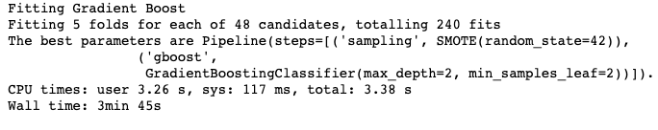
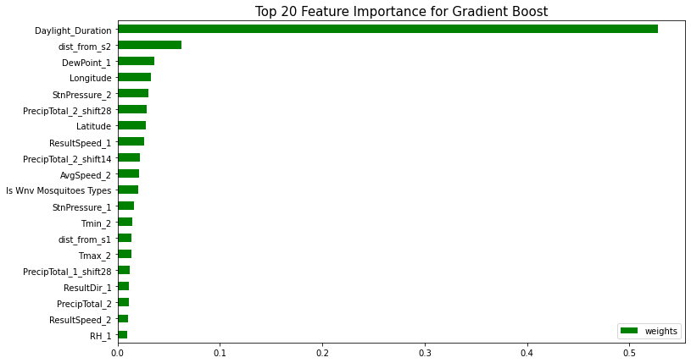
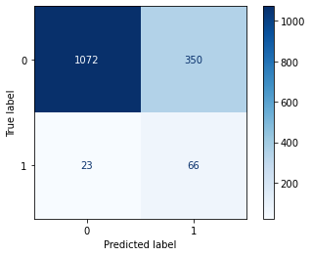
Model Training and Selection
GradientBoost
- Though there is a slight greater overfitting for GradientBoost compared to Logistic Regression, however, GradientBoost scored slightly higher on the Train and Test Scores.
- Its algorithm is more robust to outliers than AdaBoost.
Confusion Matrix
Out of 1511 data points in our test dataset, the model managed to classified 1138 (75.31%) correctly.

Slide 17
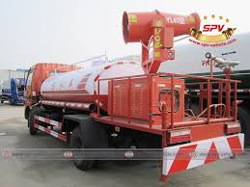
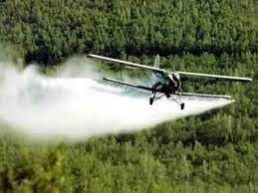
Cost Benefit Analysis
Methods
Aerial Spraying – Via airplanes or helicopters.
Trucks
Possible pesticides used for spraying
Anvil (Most commonly used to control the West Nile virus in outdoor residential and recreational areas)
Duet (Highly recommended for mosquito control)
DeltaGard (Fast acting effective insecticide)
Cost Benefit
Based on a research journal* supported by Montana State University and the Montana Agricultural Experiment Station done in 2005, it would cost the county of Sacramento, California 2,574km² in size approximately USD$700,000 gross. If we do a very simplistic calculation, it will cost roughly USD$272 per km². Which would translate to a cost of only USD$164,859 for the city of Chicago.
In the 2005 West Nile Virus outbreak in Sacramento County, the cost of medical treatment and steps taken to contain the outbreak was approximately USD$3 million. And it was calculated that the spray would only need to prevent just 15 WNV cases for it to be worthwhile financially. *
As such we would recommend that the City of Chicago take action as soon as the WNV is detected in an area and slowly fine tune over time the models we’ve created to pinpoint areas to concentrate on when certain factors are in play.
*Source: https://www.ncbi.nlm.nih.gov/pmc/articles/PMC3322011/

Slide 18
Cost Benefit Analysis
 | Sacramento City | Chicago
Population | 531,285 | 2,677,643
Population Density (Persons/Square Mile) | 5,436.30 | 11,744
No of Infected People | 163 | 1,775
Total Medical Cost (USD) | 2,979,037.00 | 32,440,433.59
Area of Spray (Square Miles) | 184 | 228
Total Cost of Spray (USD) | 701,790.00 | 869,609.35
Net Benefit (USD) | 2,277,247.00 | 31,570,824.24
Assuming that the WNV outbreak occurred in Sacramento City (In Sacramento County) and Chicago sprayed the whole city with pesticides once, Chicago would save USD 31 millions in potential medical cost if no citizen was infected with WNV.

Slide 19
Conclusion
While the model chosen is roughly 75% accurate in detecting the West Nile Virus, it is better than the null model in a sense where null model just assume all traps have no WNV present.
Although the model is unable to predict at a very high accuracy rate (e.g. 90+%), we should still use it to conduct spray at those predicted spots.
Based on our analysis of the data, the WNV is more active during higher temperatures, shorter daylight hours and during wet weather conditions. As we tune the model further and collect more data, the model would be able to predict with even higher accuracy the possible presence of the WNV and preventive measures can be taken ahead of time.
On the cost benefit analysis of spraying as an early preventive measure, there are a few ways to go about doing it either by truck or aerial, using a range of pesticides. Looking at a past WNV outbreak in Sacramento we see that it is financially prudent to do so. However more in-depth studies could be done to further enhance the effectiveness of the perhaps by looking at the population density.
As earlier mentioned, we dropped the 'NumMosquitos' column as one of the features of our model as we were unable to create a good enough linear regression model to predict the 'NumMosquitos' in our test dataset. Moving forward, we can try to create a classification model instead of a Regression model, since 'NumMosquitos' will always be an integer value. So, Class 1 = 1 Mosquito, Class 2 = 2 Mosquitos, Class 3 = 3 Mosquitos etc. If our results are good, we can then look to include 'NumMosquios' as one of the features of our final selected model.
Furthermore, we can also look to include how densely populated each of the location is as part of our features. This is because, it could be that areas with a denser human population would experience a higher number of mosquitos in the area since mosquitoes feed off the blood of humans. This would increase the probability of the WNV virus too since there are more humans to transmit the virus to.
Additionally, the features/layouts of the location might be a significant factor too. Presence of forest areas, water sources, type of buildings are some examples that might affect the breeding of mosquitos, so we can look to include these features in the future to further improve our model.
Possible Improvements

